Slide 1
BANK DATA AND
SALES DATA ANALYTICS

Slide 2
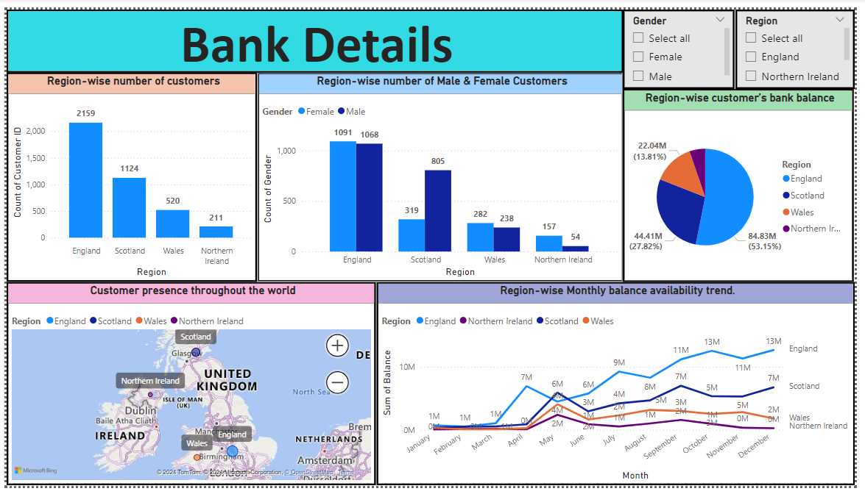

Slide 3
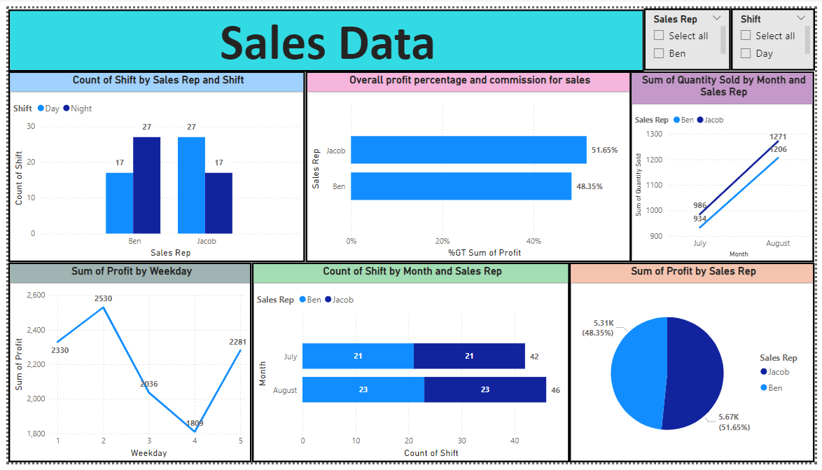

Slide 4
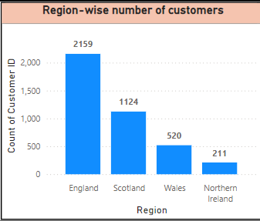
Region-wise number of customers
BANK DATA
England Dominance: England has the highest number of customers, significantly surpassing other regions.
Scotland Second Largest: Scotland has the second-largest customer base, followed by Wales and Northern Ireland.
Wide Disparity: There's a considerable difference in customer numbers between England and the other three regions.
Overall, the data suggests a concentrated presence in the England with a more distributed presence across other countries.

Slide 5
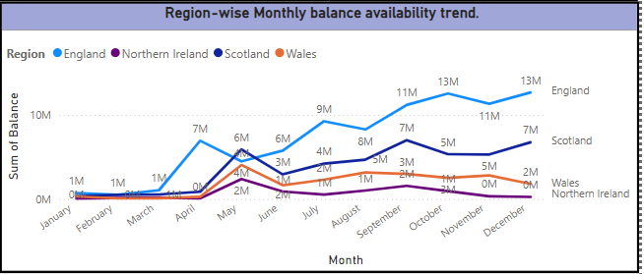
Region-wise monthly balance availability trend
England as a Growth Driver: England's consistent growth indicates a strong customer base and effective financial management.
Scotland's Steady Progress: Scotland demonstrates stable growth, suggesting a consistent customer base and financial performance.
Northern Ireland and Wales: These regions show potential for improvement in balance availability compared to England and Scotland.
The upward trend in balance availability suggests overall financial health and growth for the bank.

Slide 6
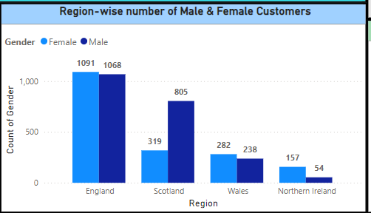
Region-wise number of male and female customers
England: Has the highest total number of customers, with a relatively balanced gender ratio.
Scotland: Shows a significant difference between the number of male and female customers, with a higher proportion of male customers.
Wales: Has a similar pattern to Scotland, with a higher number of male customers..
Overall, the chart highlights a consistent trend of more female customers across regions, with England showing a relatively balanced gender ratio.

Slide 7
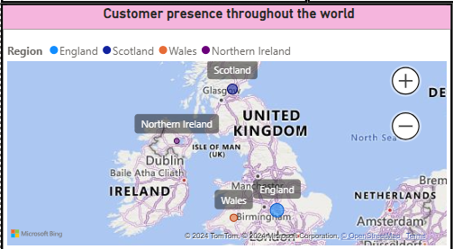
Customer presence throughout the world
UK Dominance: The map clearly indicates a strong customer presence within the United Kingdom.
England and Scotland Lead: England and Scotland appear to have the highest customer concentrations, represented by larger circles.
Wales and Northern Ireland: These regions have a visible but smaller customer base compared to England and Scotland.
Geographic Disparity: There's a clear geographic imbalance in customer distribution, with a higher concentration in England and Scotland.
Overall, Northern Ireland has very less number of customers.

Slide 8
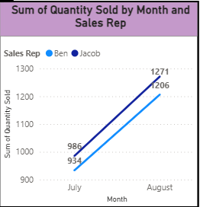
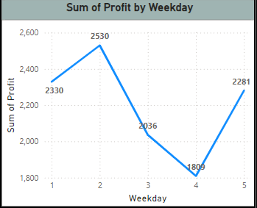
What are the areas you find for further improvement in terms of business product sales?
SALES DATA
Sales increase by weekday: Sales followed a Tuesday peak, declined through Thursday, and rebounded on Friday.
Profitability by Shift: Night Shift Sales Outperform Day Shift. High sales in night shift.
Increase in profitability by month: Both sales representatives experienced a significant increase in sales from July to August.
Overall, Sales peaked mid-week, with night shift driving higher profits, resulting in overall increased profitability from July to August.

Slide 9
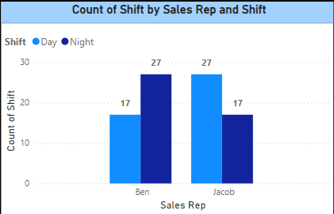
In which work shift does the sales representative mostly work?
Both sales representatives have an equal distribution of day and night shifts.
There is a consistent pattern in the number of shifts for both representatives.
Ben has more night shift but jacob has more day shifts.
Overall, Sales peaked with night shift driving higher profits, resulting in overall increased profitability from July to August.

Slide 10
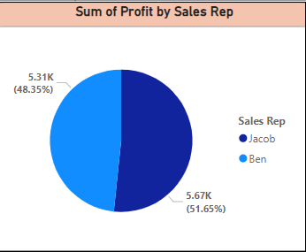
Is there any additional impact you find in business in terms of product sales trends?
There is increase in sales from july to august.
Night shift has more sales than day shifts.
Jacob has high profit and commission than ben, as he has high sales.
Overall, Sales peaked with night shift driving higher profits, resulting in overall increased profitability from July to August.

